Slide 1
Quantization and Training of Neural Networks for Efficient Integer-Arithmetic-Only Inference
學生:王品岳
指導教授:鄭桂忠教授

Slide 2
Introduction
Two main acceleration directions:
Efficient architectures (e.g., MobileNet)
Quantization
Challenge:
Quantization on large models is only proof-of-concept; the real challenge is quantizing efficient models like MobileNet.
Weight-only quantization → saves storage, not speed
Binary/Ternary/Bit-shift nets

Slide 3
Introduction
Introduces integer-only inference for higher efficiency on existing hardware
Co-designed training preserves accuracy after quantization, improving the accuracy-latency tradeoff.
Significant gains shown on MobileNets with ImageNet

Slide 4
Post-training-quantization
Post-Training Quantization (PTQ) Workflow
Train baseline model with FP32 precision
Calibrate with small dataset → collect min/max stats of weights & activations
Compute quantization parameters S (scale), Z (zero-point)
Apply quantization to baseline → get INT8 model for inference
PTQ works well on large models. But often causes significant accuracy loss on small models.

Slide 5
Contributions
Quantization scheme
Weights & activations to 8-bit, bias to 32-bit
Quantized inference framework
Runs efficiently on integer-only hardware (Qualcomm Hexagon, ARM NEON)
Quantization-aware training (QAT)
Co-designed with inference to preserve accuracy

Slide 6


Quantization scheme
affine mapping
𝑟: real value (float)
𝑞: quantized integer
Scale (S): positive real number, defines the step size
Zero-point (Z): integer value corresponding to real 0
Each weight have its own 𝑆,𝑍

Slide 7

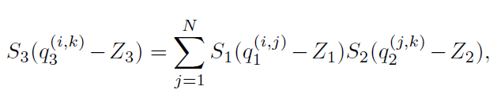
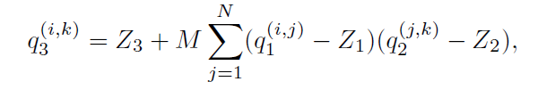



Integer arithmeticonly matrix multiplication
:fixed-point multiplier
(int16 or int32 depending on hardware capability)

Slide 8
Implementation of a typical fused layer
Quantized MatMul is extended by fusing bias addition and activation (e.g., ReLU6).
Inference fused ops must align with the placement of fake quantization nodes in training.
Ensures that the trained model and the inference computation remain consistent.

Slide 9
Implementation of a typical fused layer
Data types for the calculation process:
Weight & activation = int8
Multiply the accumulator = int32 accumulator
bias = int32 (because higher accuracy )
Processing Order:
MatMul result (int32 accumulator)
plus int32 bias
Then do scale down (implemented with fixed-point multiplication + bit-shift)
Then clamp to [0,255]
Finally, cast into uint8 → output

Slide 10
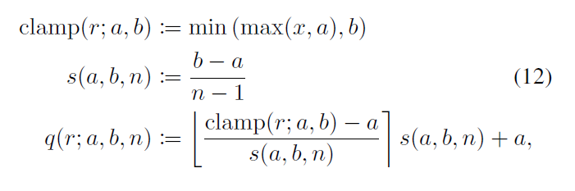
Fake-quantize
Fake quantization is essentially a combination of quantization and dequantization, simulating the error caused by rounding during quantization.

Slide 11
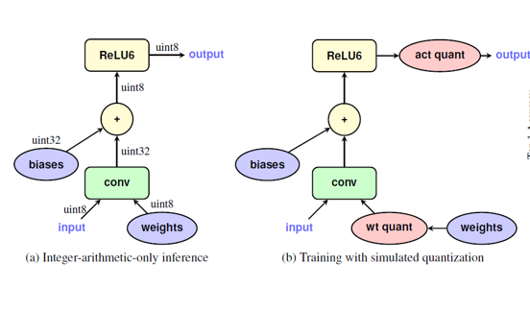
Integer-arithmetic-only quantization

Slide 12
Activation Quantization Ranges
Activation ranges depend on inputs
must be estimated during training.
Ranges [𝑎,𝑏]collected and smoothed via EMA across steps.
Problem: EMA updates too slowly when ranges shift rapidly.
Solution: Disable activation quantization early (50k–2M steps)
enable later when model stabilizes.

Slide 13
Quantized graph training and inference
Create a training graph of the floating-point model.
Insert fake quantization operations in locations where tensors will be downcasted to fewer bits during inference
Train in simulated quantized mode until convergence.
Create and optimize the inference graph for running in a low bit inference engine.
Run inference using the quantized inference graph.

Slide 14
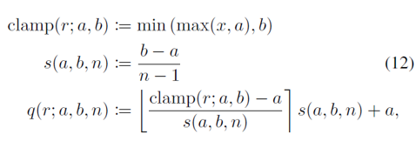
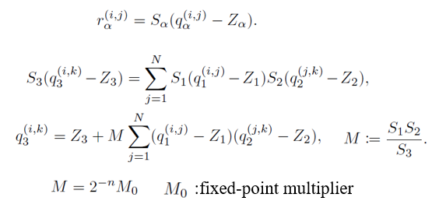
Different between two equations

Slide 15
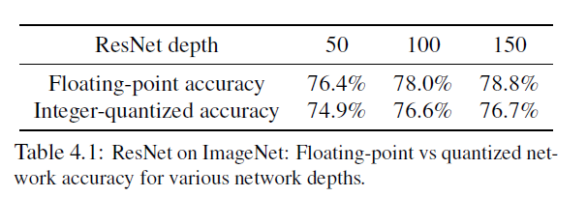
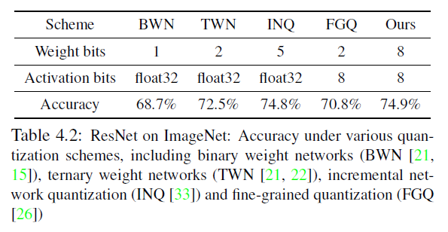
Result

Slide 16
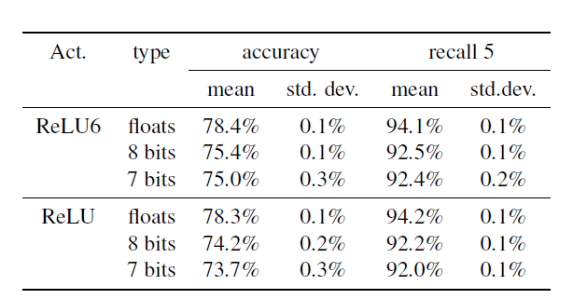
Result

Slide 17
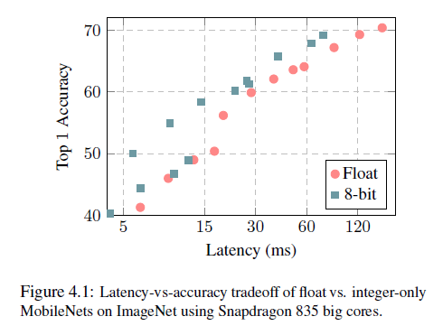
Quantization of MobileNets

Slide 18
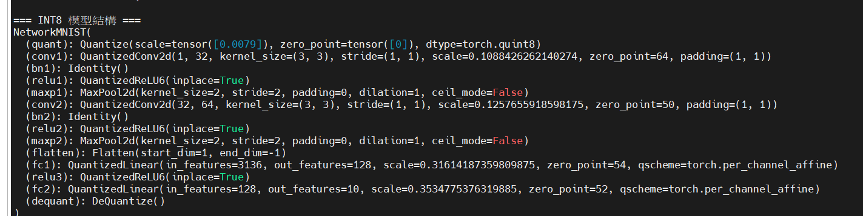
Progress

Slide 19
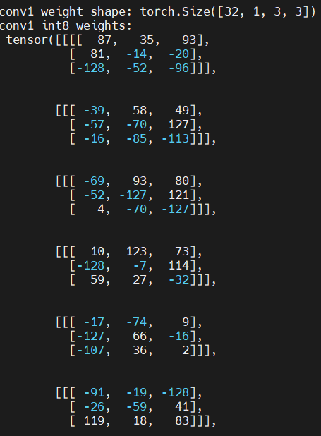
Progress

Slide 20
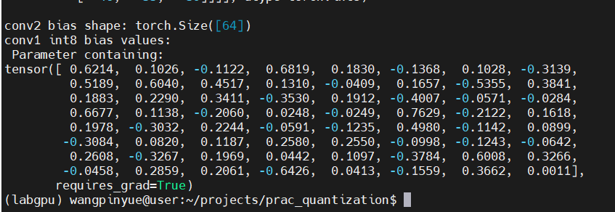
Progress

Slide 21
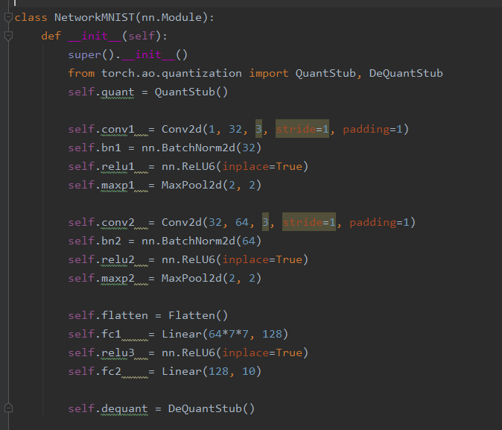
Progress

Slide 22
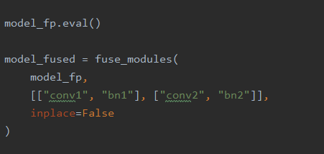
Progress

Slide 23
The END

